Slide 1
git (and then some) part 3
Asya Shklyar
March 2018

Slide 2
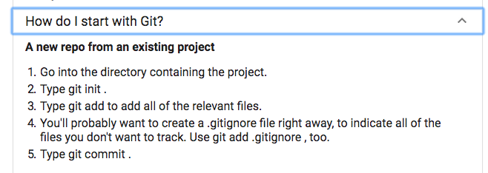
Basics: from scratch

Slide 3
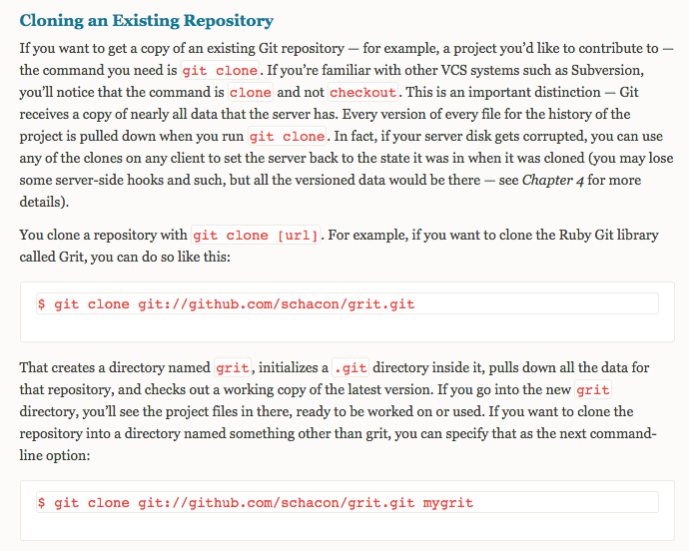
Basics: from someone else’s repo
https://git-scm.com/book/en/v1/Git-Basics-Getting-a-Git-Repository

Slide 4
git clone vs git checkout vs git pull
git clone is to fetch your repositories from the remote git server. git checkout is tocheckout your desired status of your repository (like branches or particular files). E.g., you are currently on master branch and you want to switch into develop branch.
https://stackoverflow.com/questions/7298598/what-is-the-difference-between-git-clone-and-checkout
In the simplest terms, git pull does a git fetch followed by a git merge . You can do agit fetch at any time to update your remote-tracking branches under refs/remotes/<remote>/ . This operation never changes any of your own local branches under refs/heads , and is safe to do without changing your working copy.
https://stackoverflow.com/questions/292357/what-is-the-difference-between-git-pull-and-git-fetch

Slide 5

Cheat Sheet
https://www.git-tower.com/blog/git-cheat-sheet/

Slide 6
Branch vs Fork 1
In git, branch is a light weight thing that is often temporary and may be deleted. Afork (on github) is a new project that is based on a previous project. You clone a repository to do work on it as a team member. Many public projects have you fork the project to keep the working changes out of the main project.
https://softwareengineering.stackexchange.com/questions/237433/git-branch-or-fork

Slide 7
Branch vs Fork 2
The Definitive Guide to Forks and Branches in Git
Feb 21, 2017 | Using Git
Open source patterns don’t always make the most sense for business.
Their goals are a bit different: open source favors experimentation, where business tends to want focus in order to reduce time to market.
Structural choices tend to mirror these goals. And the decision to use a forks or branches to work on features can have an appreciable impact a team’s overall productivity.
Forking tends to empower a divergent evolution of the codebase, which makes it ideal for an environment that’s looking to empower broad experimentation on a theme.
Branching, on the other hand, caters toward convergent evolution. This tends to be a better fit for private repositories, and why it is commonly used by enterprise companies and in most business contexts.
https://blog.gitprime.com/the-definitive-guide-to-forks-and-branches-in-git/

Slide 8



Git Workflows
https://git-scm.com/book/en/v2/Git-Branching-Branching-Workflows
https://buddy.works/blog/5-types-of-git-workflows
Basic – Feature Branch – Gitflow

Slide 9
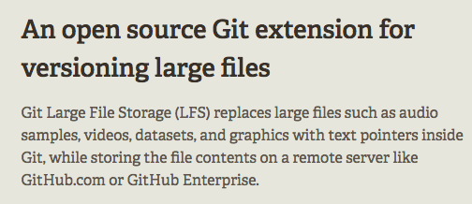
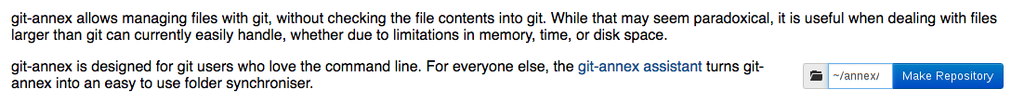
Large Files, Binaries
git-lfs https://git-lfs.github.com/
git-annex https://git-annex.branchable.com/
Attaca (Rust) https://github.com/attaca/attaca

